Slide 1
Meatless Monday At School
April 2021

Slide 2
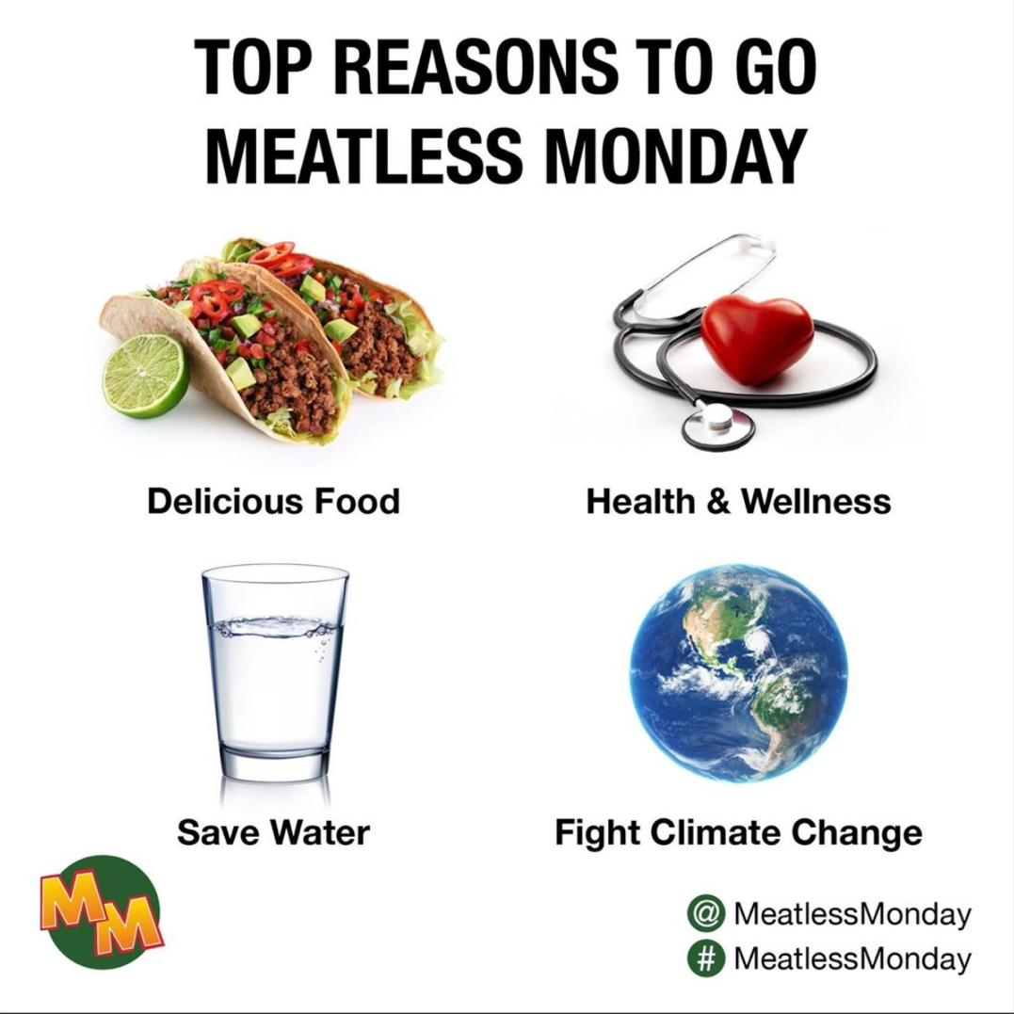
Why Meatless Monday?
Meatless Monday encourages people to cut meat from their diets one day a week to promote personal and environmental health.
Notes:
Meatless Monday – good for you. Good for the planet.
scientifically proven to help people lower their risk of certain diseases and maintain a healthy weight.
From an environmental perspective – reducing meat consumption is one of the BEST ways to reduce our environmental footprint, fight climate change and conserve water

Slide 3


About Meatless Monday
Notes:
https://www.youtube.com/watch?v=6_W8YSeTWnE

Slide 4
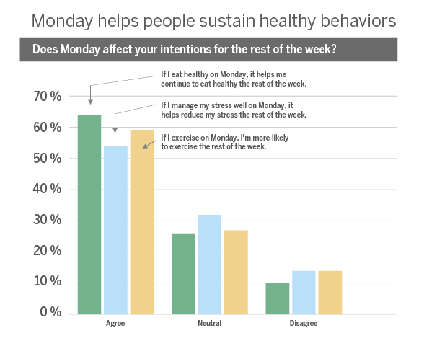
Why Monday?
Studies show Monday is the best day to begin healthier habits.
Notes:
Monday has been proven to be the best day of the week to start a healthy habit – especially around eating healthier.
https://www.mondaycampaigns.org/research
You can think of it as a mini New Year’s Resolution. Every Monday is a fresh start to kick start your healthy goals

Slide 5

Who’s going Meatless Monday?
Notes:
Meatless Monday is a global movement practiced by individuals, celebrities, companies, schools, and cities. Most national restaurant chains, grocery stores, and food brands now have delicious plant-based meal options so it’s easier than ever to go Meatless Monday.

Slide 6
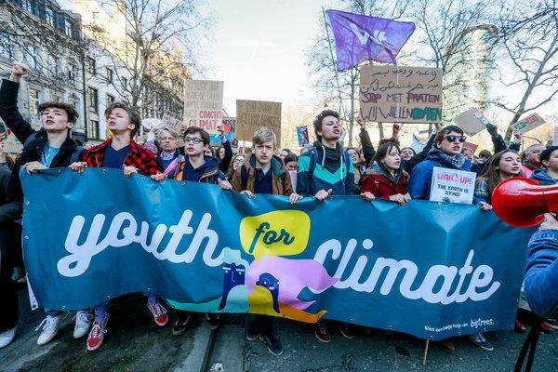

Why Meatless Monday in Schools?
Environmental Action for the Future
Healthy Habits for the Future
School Leadership and Innovation
Notes:
Now more than ever, students are concerned about their personal health and the health of the planet. Meatless Monday is an easy and tangible way for schools and teachers to show their commitment to supporting student wellness, global sustainability, and help kids develop healthy eating habits.

Slide 7
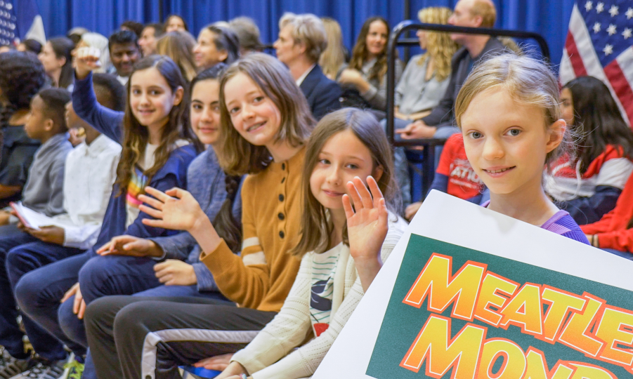
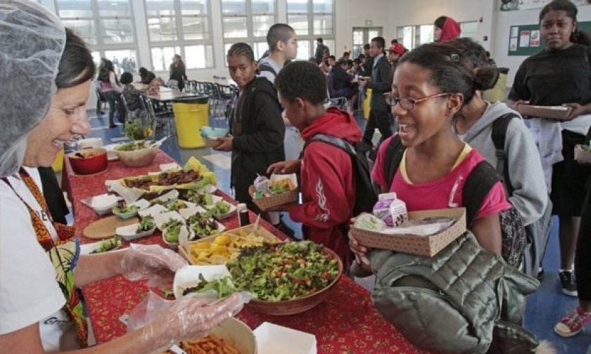
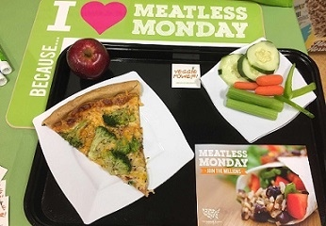
Meatless Monday in Action
Millions of K-12 Students
Go Meatless Monday Every Week
NYC Public Schools
Chicago Public Schools
El Paso Public Schools
Los Angeles Public Schools
Philadelphia Public Schools
Hundreds more…
Notes:
https://www.mondaycampaigns.org/meatless-monday/news/nyc-expands-meatless-monday-schools
Students and school districts across the country are going Meatless Monday every week, including New York City Public Schools (1.1 million students), Chicago Public Schools, El Paso, and Los Angeles…. And more

Slide 8
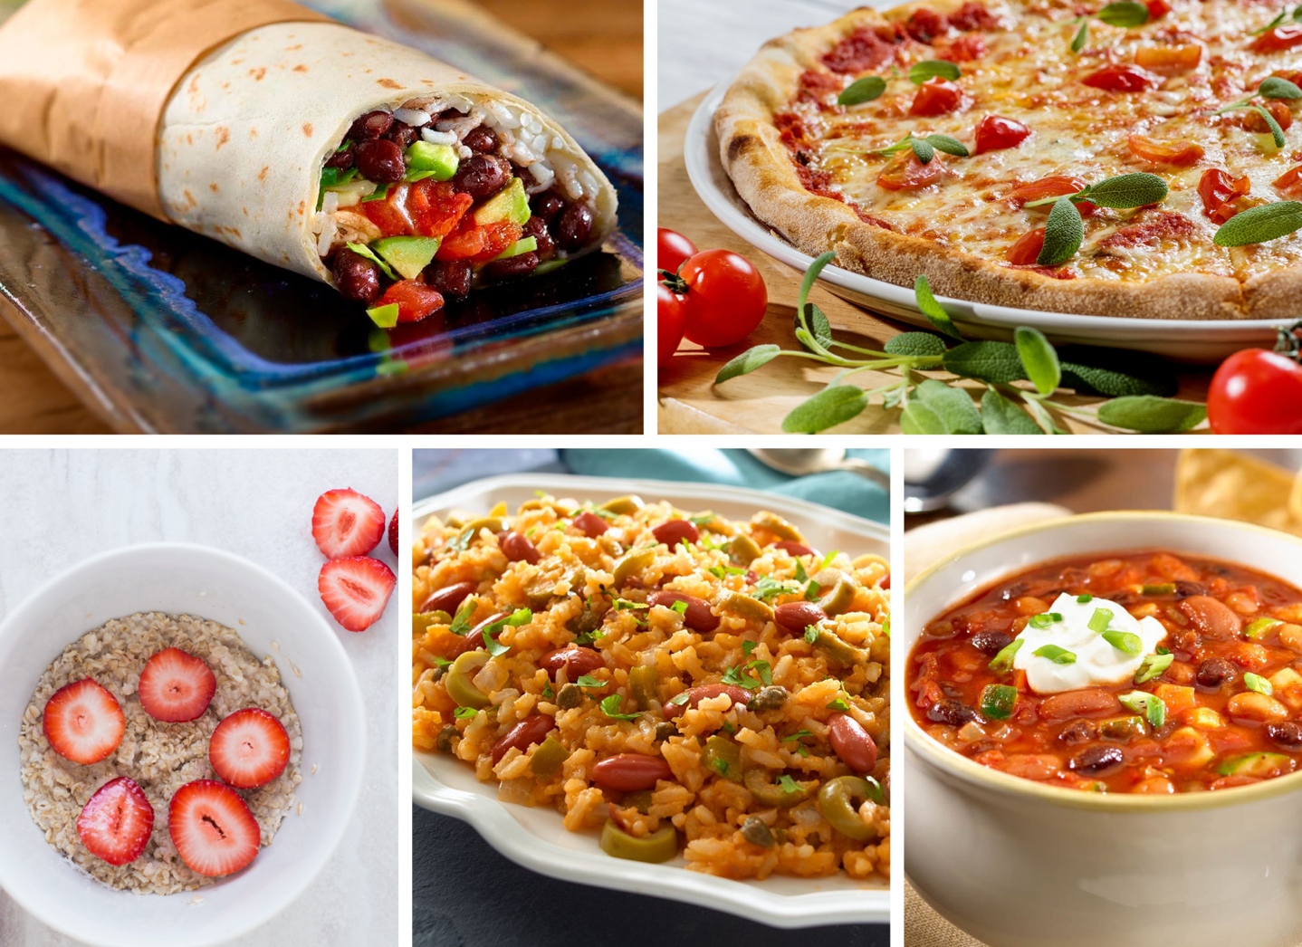
What’s On the Menu?
All your kid’s favorites, made plant-based.
School Meatless Monday meals follow K-12 nutritional guidelines.
Notes:
There are so many plant-based meals available, schools can easily find kid-friendly meals that are healthy and delicious. Such as burritos, tacos, pizza, and chili.

Slide 9
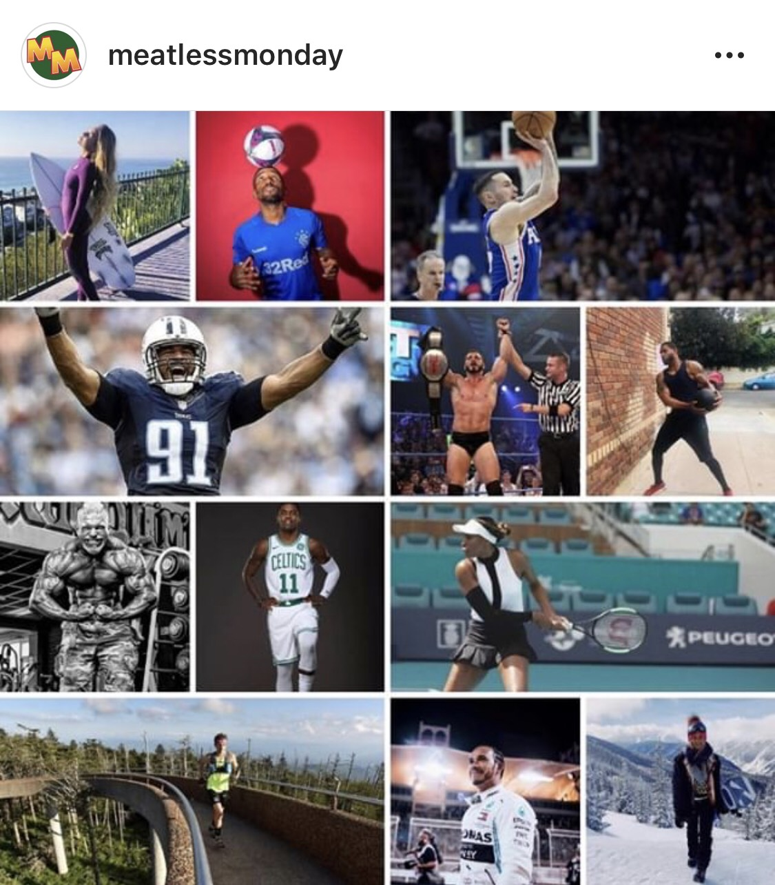
Plant-Based Protein...Not to Worry
Most Americans eat 1.5 times more protein than they need each day.
Nuts, beans, and grains can be especially high in protein.
A healthy meatless diet will provide more than enough energy, protein, and other nutrients to fuel all your usual activities, including workouts.
Protein deficiency is very rare, even in full-time vegetarians.
Eating excessive amounts of processed and red meat carries risks you won’t find with plant-based protein.
https://www.mondaycampaigns.org/meatless-monday/research/nutrition
Notes:
You can easily get the full U.S. recommended daily allowance of protein each day without eating meat, and plant-based protein is an excellent choice.
https://www.mondaycampaigns.org/meatless-monday/research/nutrition

Slide 10
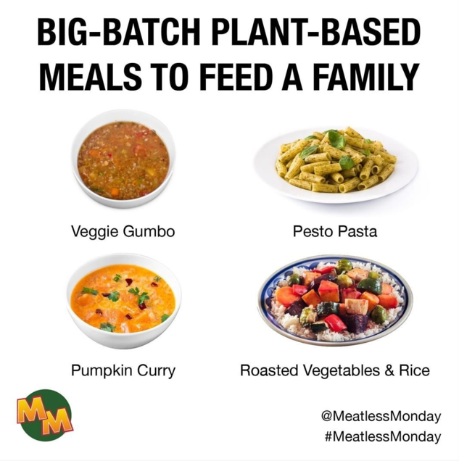


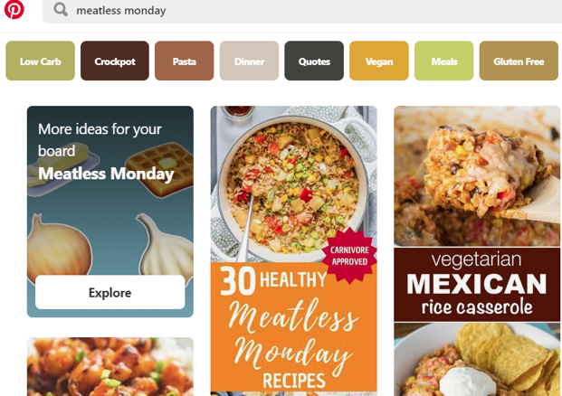
Meatless Monday at home…
@MeatlessMonday
MeatlessMonday.com
KidsCookMonday.com
Notes:
Bring Meatless Monday home and try delicious plant-based recipes the whole family will enjoy. Meatless Monday has hundreds of recipes to choose from and family cook-along recipes from The Kids Cook Monday.
https://www.mondaycampaigns.org/meatless-monday/recipes
https://www.mondaycampaigns.org/kids-cook-monday/recipes

Slide 11

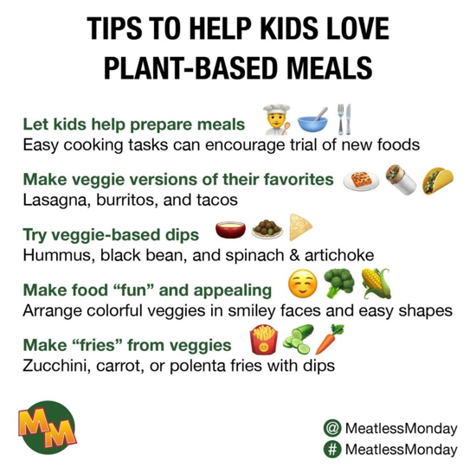
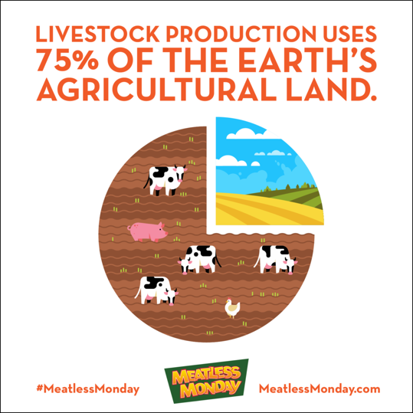
Meatless Monday Resources
Free resources available via www.MeatlessMonday.com
Social media infographics
Recipes for schools and families
Marketing materials
Scientific research
Lesson plans
Kid's activities
Notes:
Check out the Meatless Monday resource and K-12 pages for kid's activities, social media infographics, posters, videos, research from Johns Hopkins, and lesson plans for all grade levels.
https://www.mondaycampaigns.org/meatless-monday/resources
https://www.mondaycampaigns.org/meatless-monday/k-12-schools

Slide 12

Thank you!
Contact Meatless Monday: info@meatlessmonday.com
#MeatlessMonday
@MeatlessMonday
www.MeatlessMonday.com

